Slide 1
Basic UI controls

Slide 2
Main content
WPF & XAML
Window, MessageBox, Dialog
Button
Label
TextBox / TextBlock
Image
CheckBox / RadioButton
ProgressBar / Slider

Slide 3
WPF & XAML

Slide 4
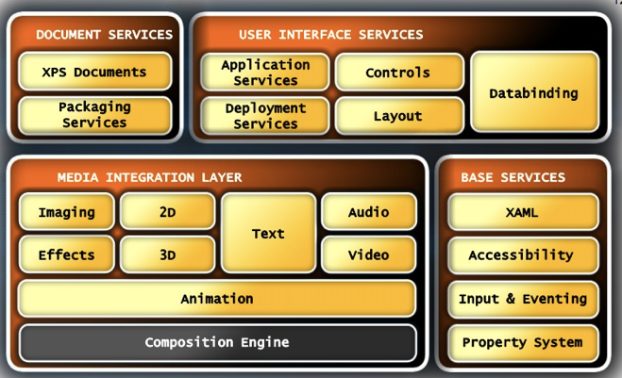
Windows Presentation Foundation

Slide 5
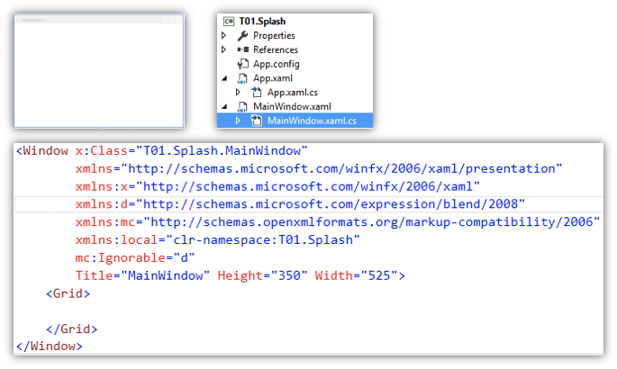
Hello world
XAML for UI creation
C# Code behind to handle business logic

Slide 6
Characteristics
Seperation
User Interface (XAML)
Business logic (C# - code behind)
Hardware acceleration
Vector based graphics: zooming without quality degrade

Slide 7
Window & Dialog

Slide 8
Some common properties
Title
Icon
WindowStartupLocation:
CenterScreen
Width, Height
WindowState (Maximized )
ShowDialog() vs Show()

Slide 9
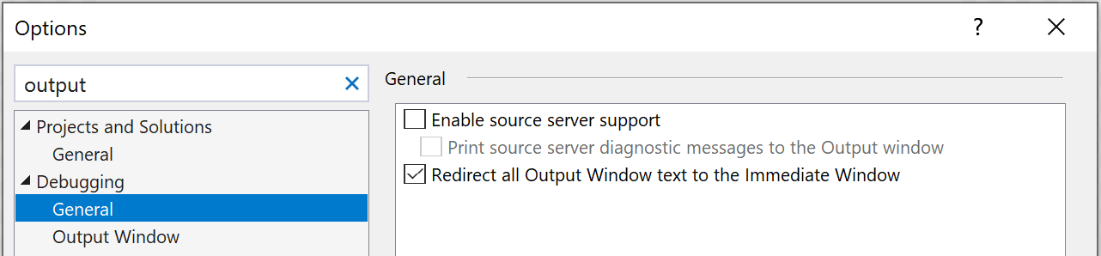
Adding debug information
Debug.WriteLine
Choosing Intermediate rather than Output

Slide 10
Common events
Loaded
All UI elements have been created
Load / Initialize data here
Closing (Trước khi đóng cửa sổ)
Cleanup if necessary
Closed (Sau khi đóng cửa sổ)
Process > Window

Slide 11
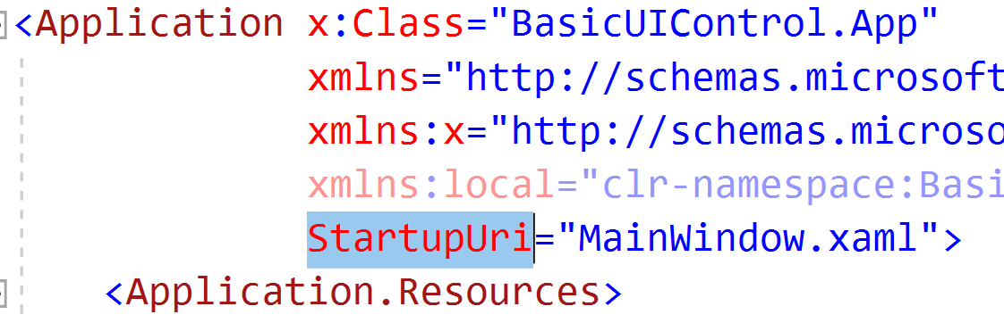
Startup window
App.xaml

Slide 12
MessageBox

Slide 13
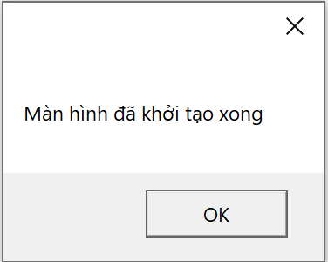
Simple message

Slide 14
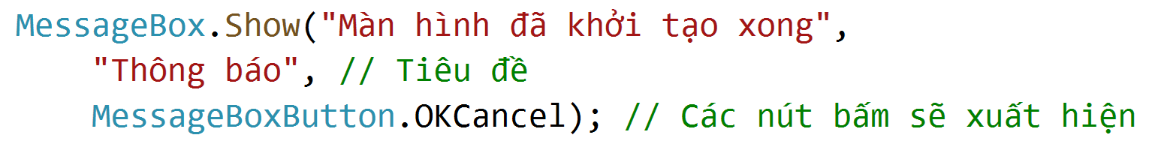
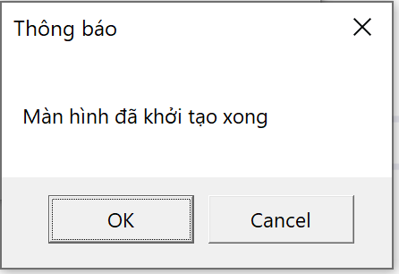
Adding title and buttons

Slide 15
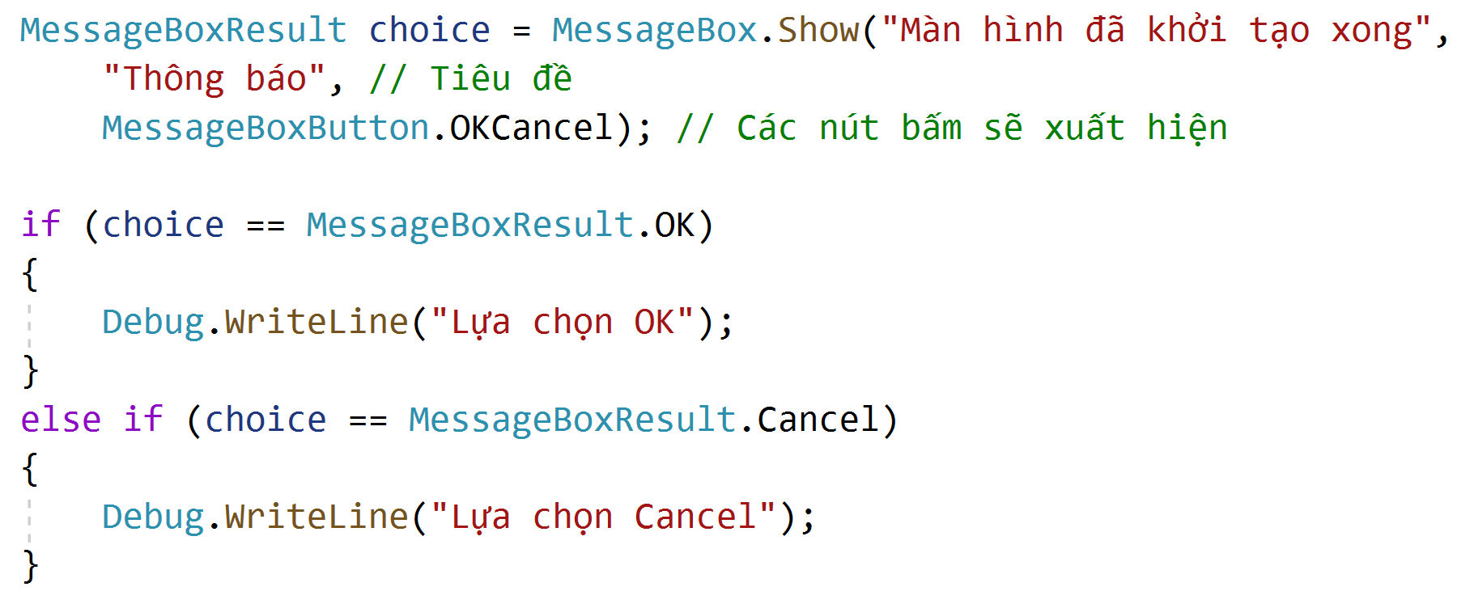
How to know which button has been clicked?

Slide 16
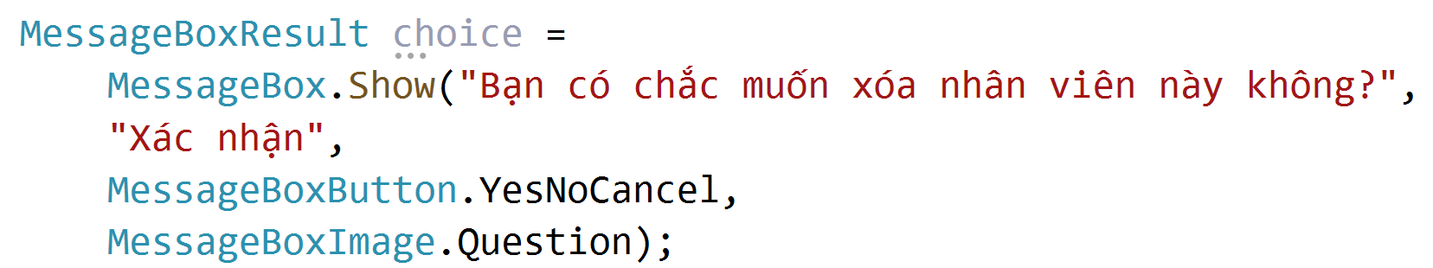
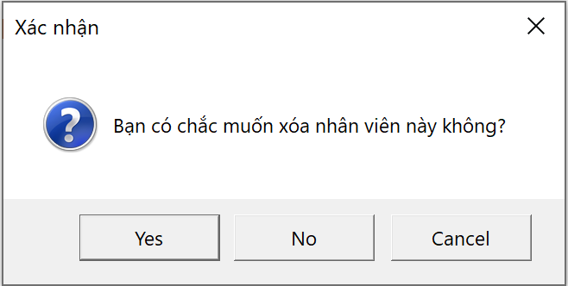
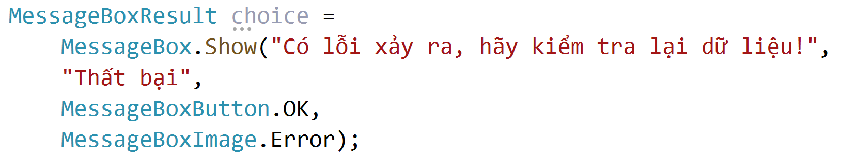
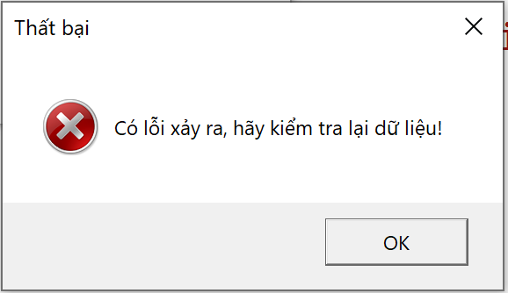
Adding icon

Slide 17
Dialog

Slide 18
Displaying a dialog
Must close the dialog before going back
Use ShowDialog(), rather than Show()
How to get result from a dialog?

Slide 19
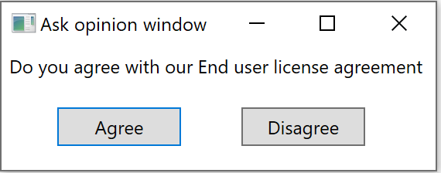
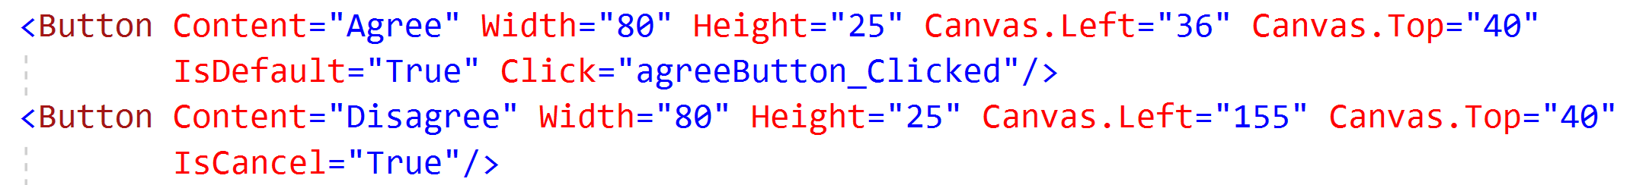
Step 1: Button prepartion
Default button, enter to trigger click event
Press Escape to activate, auto assign DialogResult = false

Slide 20
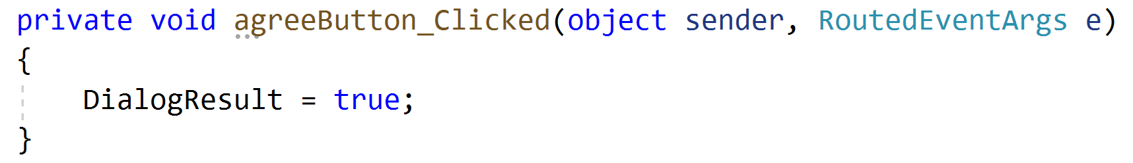
Step 2: Add handling code for Agree button
Pressing Enter will fire event Click but you have to manually assign DialogResult = true

Slide 21
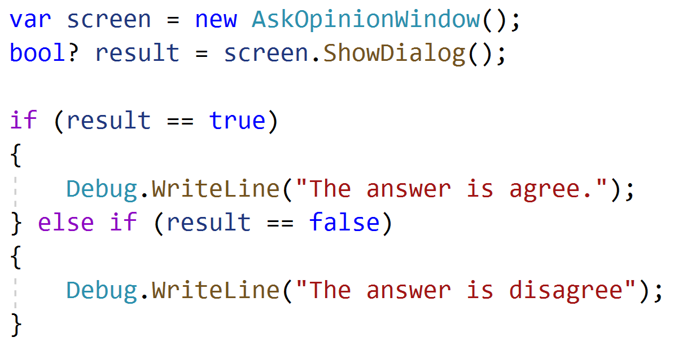
Step 3: Showing dialog and handling result

Slide 22
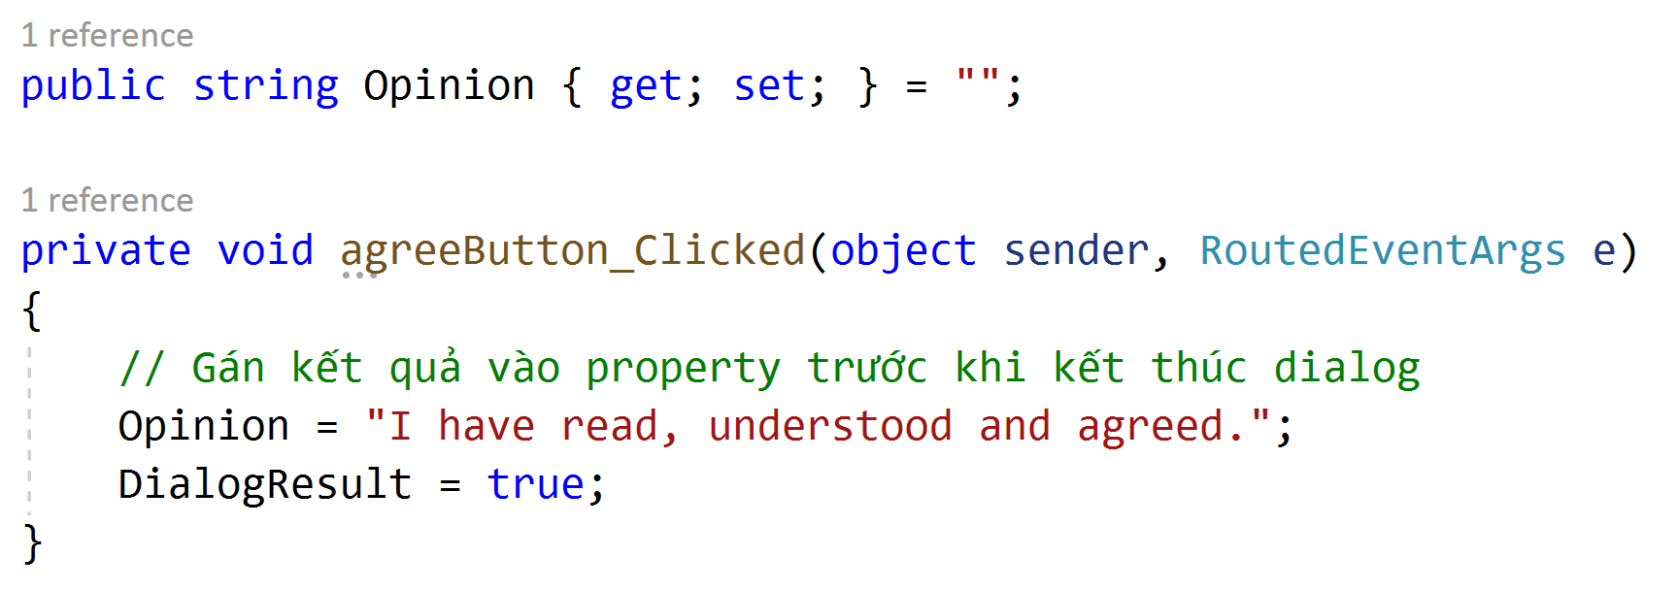
Getting success dialog result – The easy way
Use public attribute / property

Slide 23
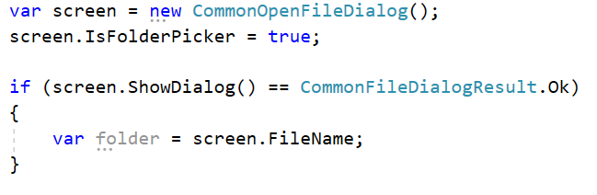
CommonOpenFileDialog
Nuget package: Microsoft.WindowsAPICodePack-Shell

Slide 24
Image

Slide 25
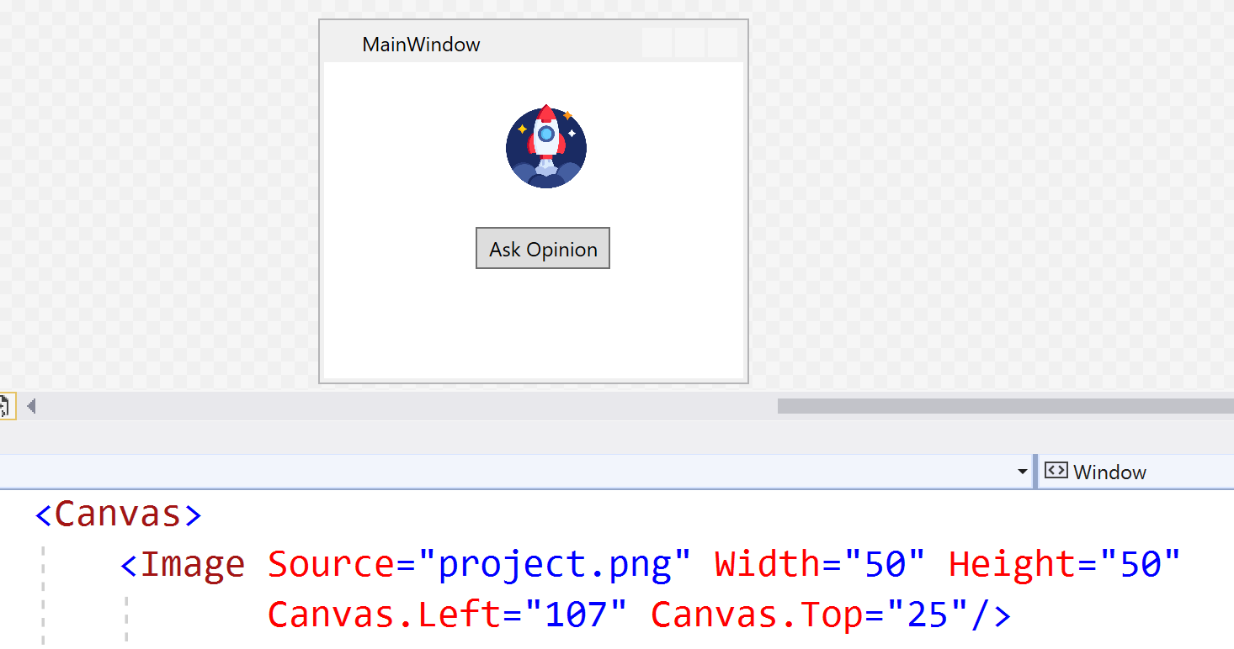
Adding image to project and display
From VS 2019, image should be set Build to Resource

Slide 26
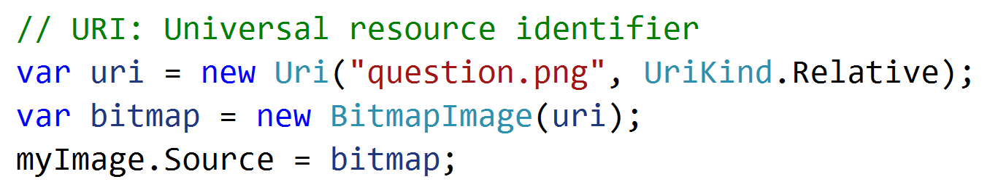
Setting image using code

Slide 27
Image quality
RenderOptions.BitmapScalingMode

Slide 28
Button

Slide 29
Common properties & Event
Content
Click

Slide 30
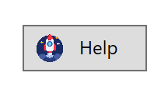
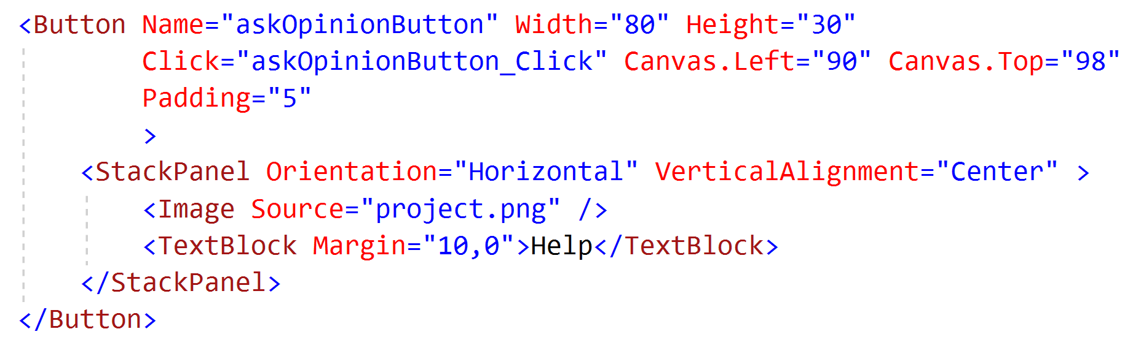
Adding image to button

Slide 31
Label / TextBlock

Slide 32
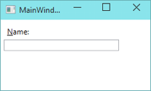
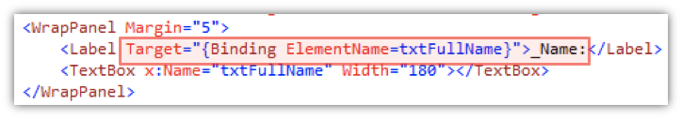
Label
Target: the control that will get focus when press Alt + N

Slide 33
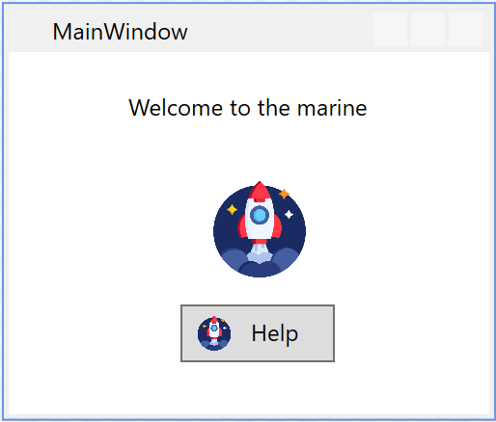
TextBlock
Pure text display

Slide 34
TextBox

Slide 35
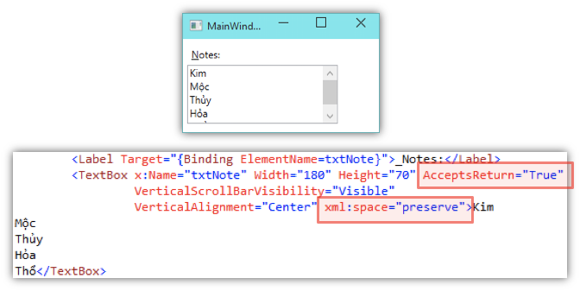
Textbox
AcceptsReturn = True

Slide 36
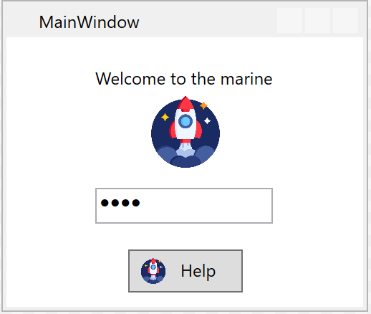
PasswordBox - PasswordChar

Slide 37
TextBox placeholder
No direct support
Use transparent textbox below

Slide 38
In-class exercise 01 – Login screen
Create a login screen with two textbox for username and password
Textbox should not be left empty
Enable using Alt + U to focus on the textbox Username
Enable using Alt + P to focus on the textbox Password

Slide 39
Improvement
If username = “admin” and password = “qwe3@1”
then goto Dashboard / MainWindow (empty)

Slide 40
CheckBox

Slide 41
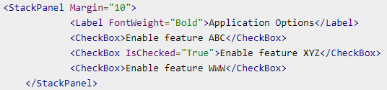
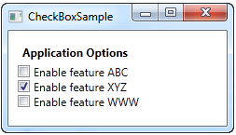
Simple checkbox

Slide 42
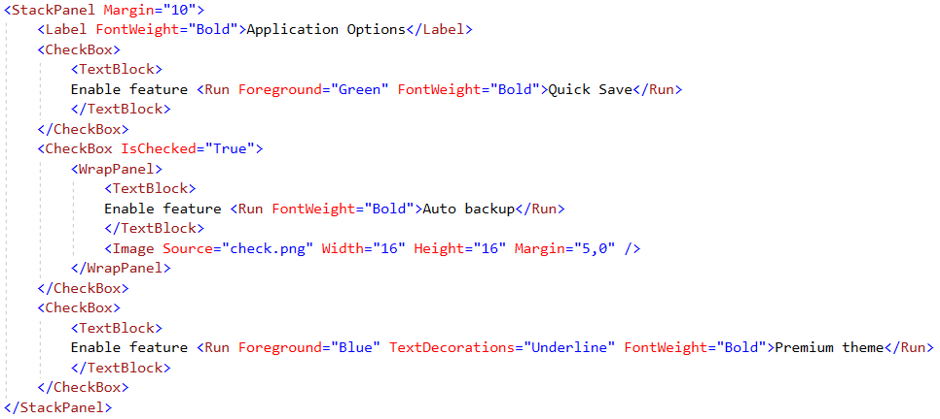
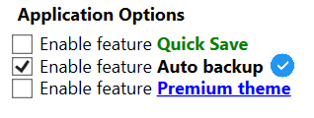
Complex checkbox

Slide 43
Things to focus
CheckedChanged
IsChecked

Slide 44
RadioButton

Slide 45
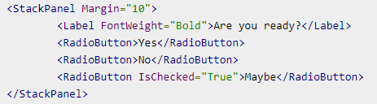
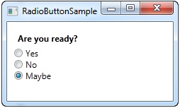
Simple radio button

Slide 46
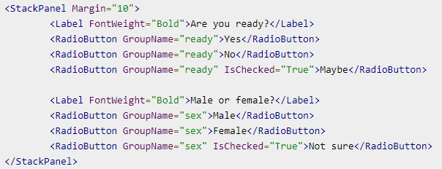
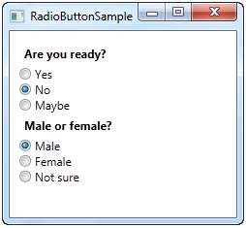
Grouping

Slide 47
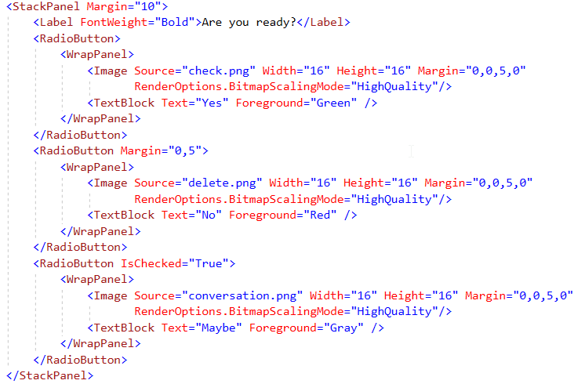
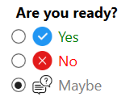
Tùy biến Radio Button

Slide 48
ProgressBar

Slide 49

ProgressBar
Minimum
Maximum
Value: Current value

Slide 50
Slider
Like ProgressBar, but can adjust value directly

